Slide 1
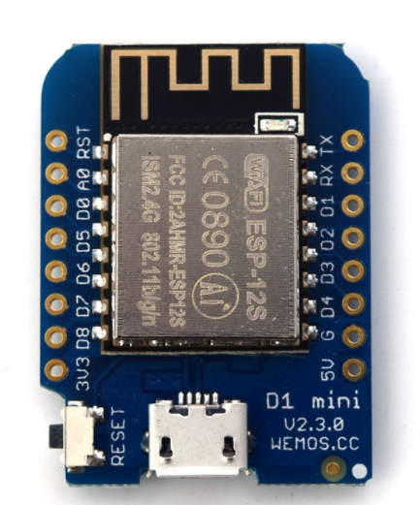
Material Science Stephen Fisher, PE
UND Senior Design Project;
Local HVAC example D1 Mini by Wemos
Arduino platform clone
One thermistor sensor on local WI-FI for critical food storage applications
ThinkSpeak on-line graphing, monitoring and alarms
Google documents / Personal web site
Notes:
UND project notes- PowerPoint
Marvin Windows and Doors
Stephen Fisher, PE
8/22/2017

Slide 2
Material Science Stephen Fisher, PE
Need;
Home monitoring of conditions around window products in buildings
Jeld-Win in Oregon does this for themselves and other critical applications, libraries, materials storage, etc,.. Marvin has a number of HoBo field sensors and monitors
GSM phone is often needed because of Wi-Fi password security
Off the shelf-parts, assembly, integration into user-friendly systems
Open hardware, software systems available to others on project web-site. BOM download counter. Stand alone web domain; http://www.project_name.org/

Slide 3
Material Science Stephen Fisher, PE
Desired attributes;
BeagleBone, Arduino example (low-cost focus)
Wi-Fi and GSM cell external link
Multiple temperature, %RH and differential pressure sensors (other generic, low-voltage inputs)
OneDrive or Google document data storage
Phone App, live data charting, Marvin controlled web-site for confidential access by password
Power off-on, safe power-up
Phone charger power or similar (low-power, low-voltage application)

Slide 4
Material Science Stephen Fisher, PE
Work packages;
Controller selection
Software/programing
Sensors (error analysis, power, output, calibration)
Packaging, cooling, electronic projection (robust and simple)
Perforated board, soldered assembly
Wi-Fi to store date on OneDrive
Documentation to field multiple packages
2 months of testing of final board (package design)

Slide 5
Material Science Stephen Fisher, PE
Work package, options by priority;
#1 GSM phone data transfer
#2, Remote software upgrades
#3, Solar power – battery options
#1, Phone app graphing (android), website secure monitoring, and data presentation

Slide 6
Material Science Stephen Fisher, PE
Project plan printed copies and by email;
stfisher@Marvin.com
Contact information;
Stephen Fisher, PE
stfisher@Marvin.com
218-386-4141, 6-1737
8/22/2017

